Slide 1
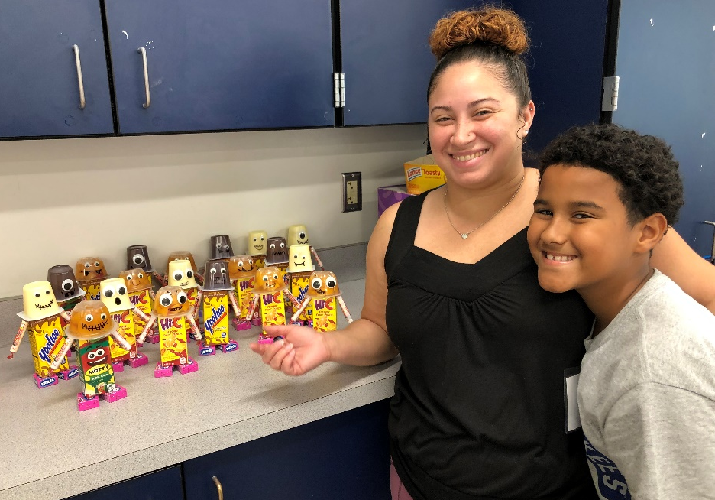

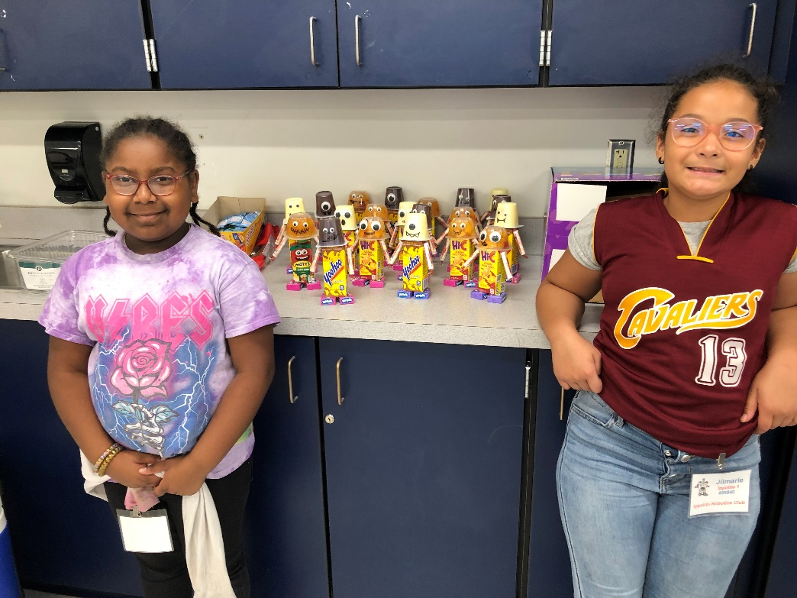

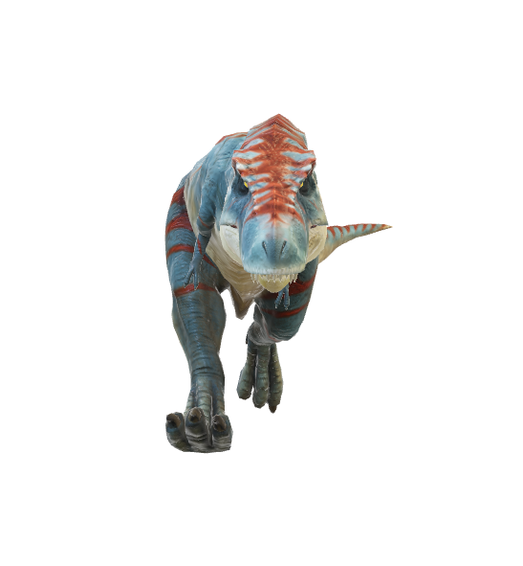
Welcome to
IPPOLITO Otterbots
Coaches
Mrs. Melton Mr. Melton
Mrs. Graves Miss Pang
Mr. Scruggs Officer Vega

Slide 2
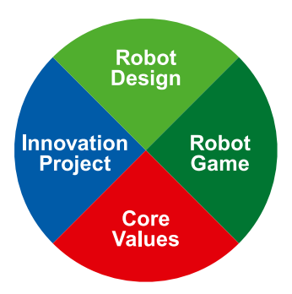
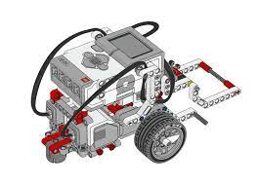
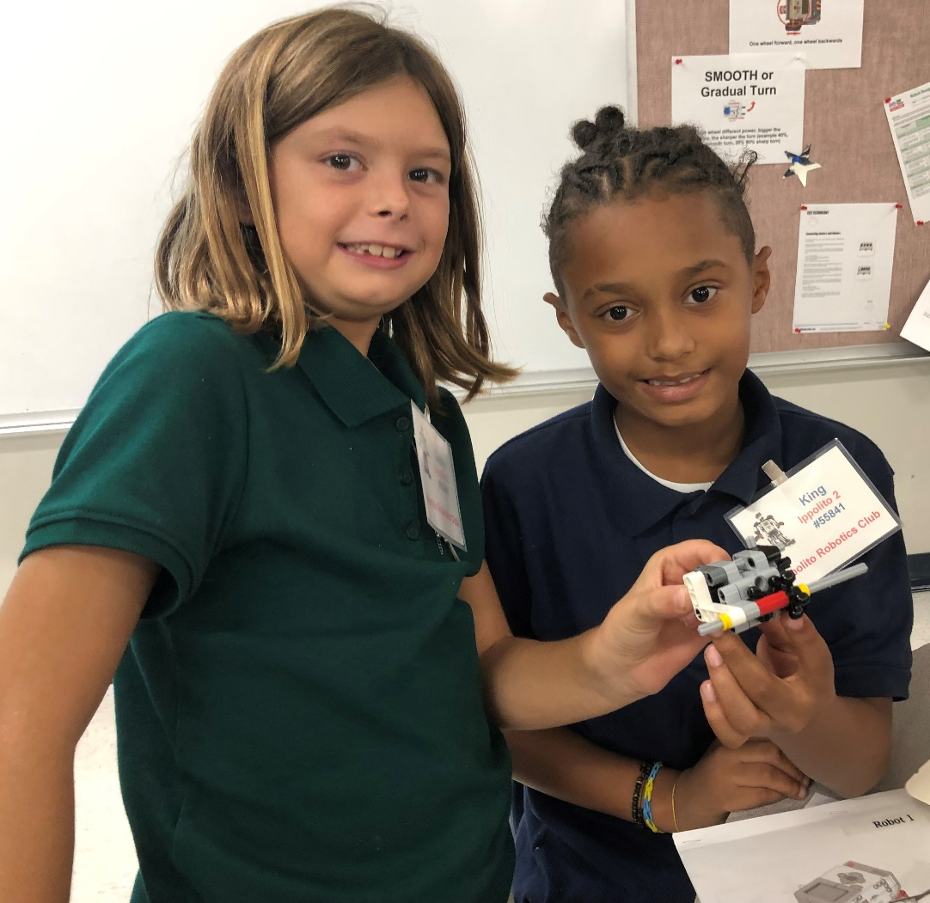


What is A robotics CHALLENGE TEAM?
Core Values
Robot Design
Robot Game
Innovation Project

Slide 3
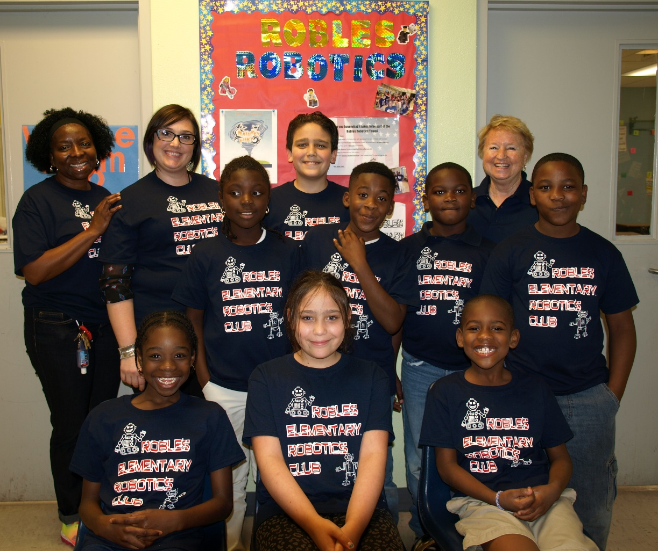

We Will Have TWO IPPOLITo Robotics teams
10 Team members per team
(Challenge teams are 3rd, 4th and 5th greades)

Slide 4
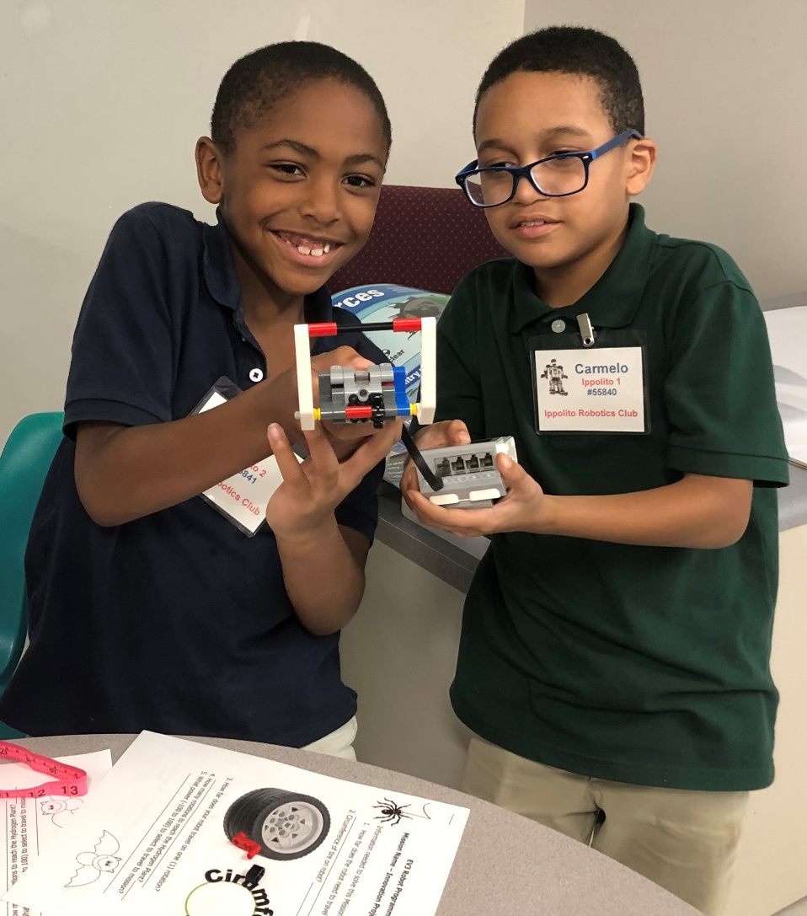

Each Team Will:
Have diversity
10 Team Members
Select a Team Name
Have team shirts

Slide 5
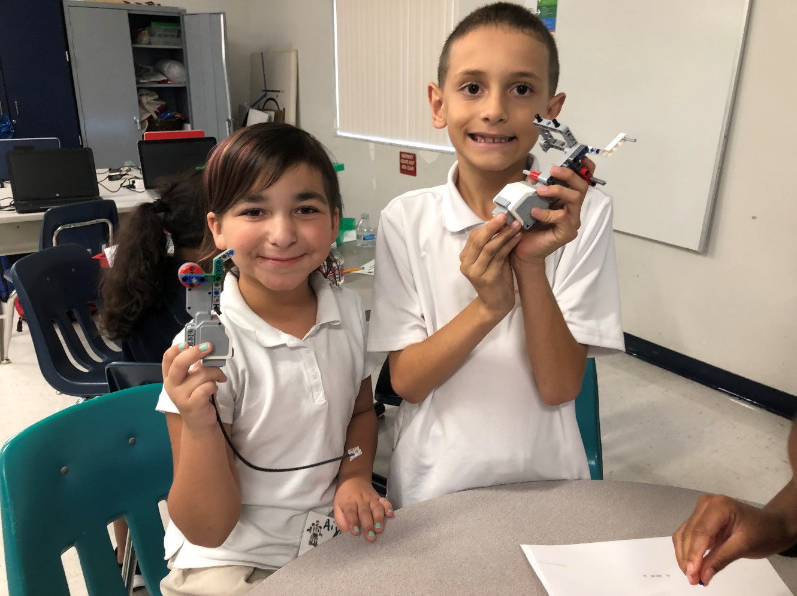
Team Names selected
  Robotics Rebels
    #55841
  Robotics Force
    #55840

Slide 6
Robotics team member jobs
Core Value Leaders
Robot Builder
Robot Design
Attachment Design
Attachment Builder
Score Strategist
Program Robot
4 Technicians per team
Check Mission Board Correct Setup
Pick Energy project topic
Research Energy Problem
Create Solution for Problem
Share Solution with Others
Create 5 minute presentation for judges
Script, props, costumes, display board
Rules for Robot Game, updates to team
Co-Captains
Create design for Storage model

Slide 7
Welcome
Notes:
FIRST® Core Values
The FIRST® Core Values are the cornerstones of the program. They are among the fundamental elements of FIRST LEGO League. By embracing the Core Values, children use discovery and exploration of the theme in each session and learn that helping one another is the foundation of teamwork. It is important that the children have fun. The more playful the sessions are, the more motivated the children will be.
Gracious Professionalism® is a way of doing things that encourages high-quality work, emphasizes the value of others, and respects individuals and the community. The team’s Core Values and Gracious Professionalism will be evaluated during Robot Game matches and during the judging session at the tournament. The team demonstrates Coopertition® by showing that learning is more important than winning and they can help others even as they compete.

Slide 8


Demonstrate Core Values
We express the FIRST philosophies of Gracious Professionalism and
Coopertition through our Core Values:
Teamwork: We are stronger when we work together
Inclusion: We respect each other and embrace our differences
Discovery: We explore new skills and ideas
Innovation: We use creativity and persistence to solve problems
Impact: We apply what we learn to improve the world
Fun: We enjoy and celebrate what we do!

Slide 9



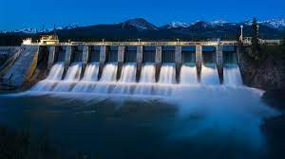
Innovation Project
Identify where Energy comes from and how it is distributed, stored and used in your community.
Identify an energy problem you are interested in researching
Create a new solution and share your idea with others
Communicate your solution in a 5 minute presentation at an event

Slide 10
Your robot’s energy journey
Plug in robot to charge battery
  Problem – electrical wire above ground
  No Wind Turbines
Where does energy come from in Riverview?
  Solar
  Oil
  Nuclear
  Natural Gas
How is it distributed
Where is it stored

Slide 11
Let’s Build A Robot
4 groups - 4 robots
Sort pieces – 2 team members
Read directions
Build a robot – 2 team members
Build medium motor and arm – 2 team members

Slide 12
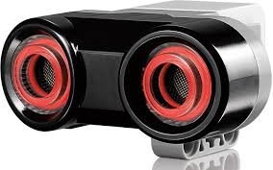
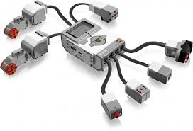
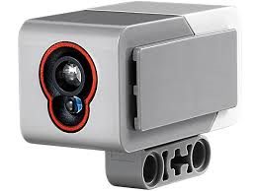
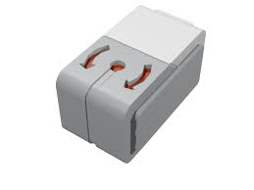
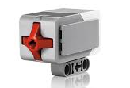
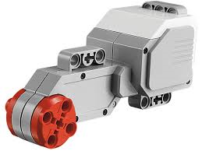
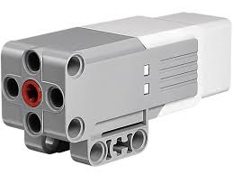
Ultrasonic Sensor
Color Sensor
EV3 Brick
Gyro Sensor
Large Motor
Touch Sensor
Medium Motor

Slide 13
Motors And Sensors
r

Slide 14
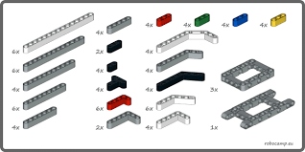
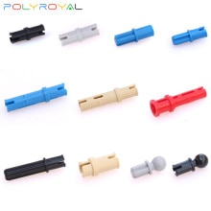
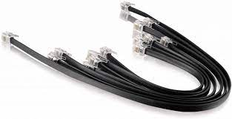
BUILDINg PIECES
BEAMS
  Straight
  Crooked
                Connectors
Wires

Slide 15
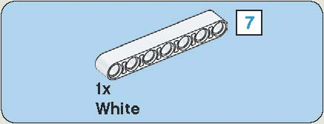
BUILDING TIPS
Square with number inside = number of holes in Lego beam.
A number 7 Axle is the same length as a beam with 7 holes.

Slide 16
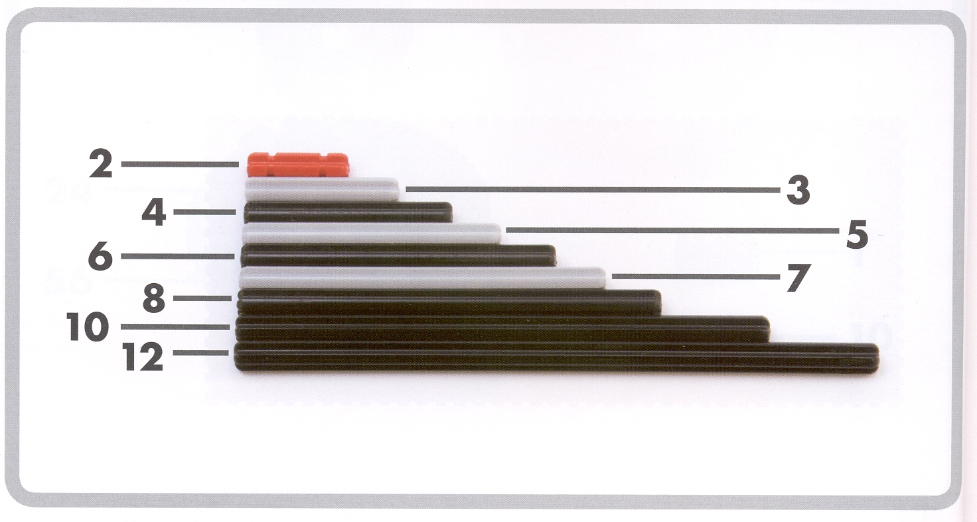
AXLE LENGTH

Slide 17

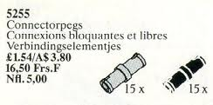

How are these pieces Different?
Long Blue connector
Gray and Black connectors
Long Tan connector

Slide 18
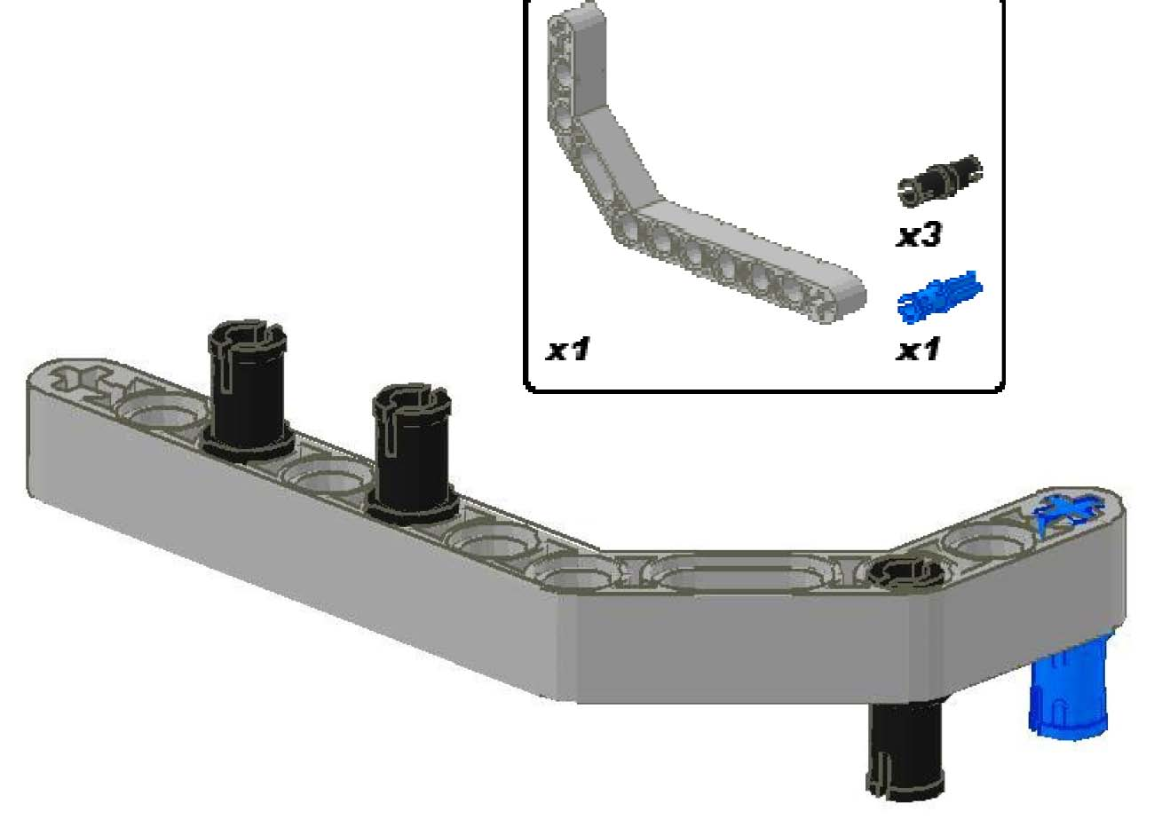
BUILDING TIPS
Rectangle with parts inside = pieces to gather first to build with

Slide 19
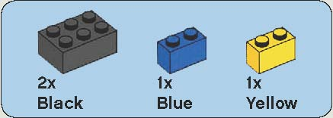
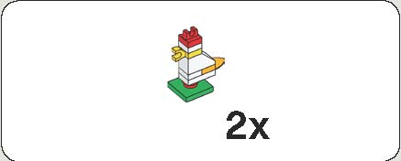
BUILDING TIPS
2x or x2 = Use ‘2’ of these parts or build ‘2’
Read color name, sometimes different than photo!-

Slide 20
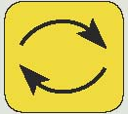
BUILDING TIPS
Round circle with arrows = turn over

Slide 21
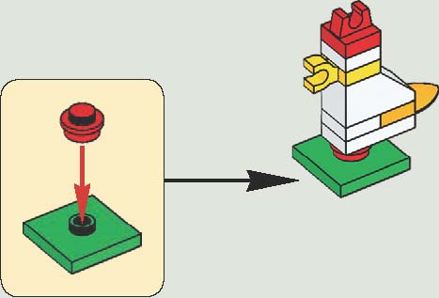
BUILDING TIPS
= Direction to place Lego parts

Slide 22
Let’s Build A Robot
4 groups
Each group builds a robot and medium motor with arm
Get out two instructions
Sort parts into tray, find parts and follow instructions, do not skip steps

Slide 23
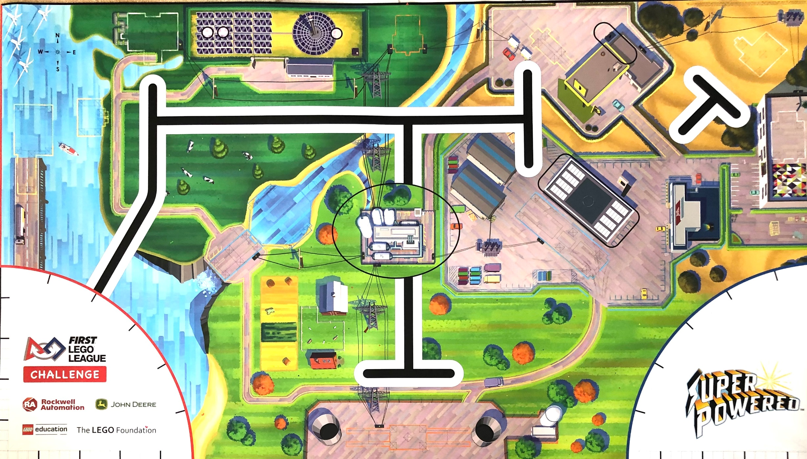

Robot Game 15 Missions – 2.5 minutes

Slide 24
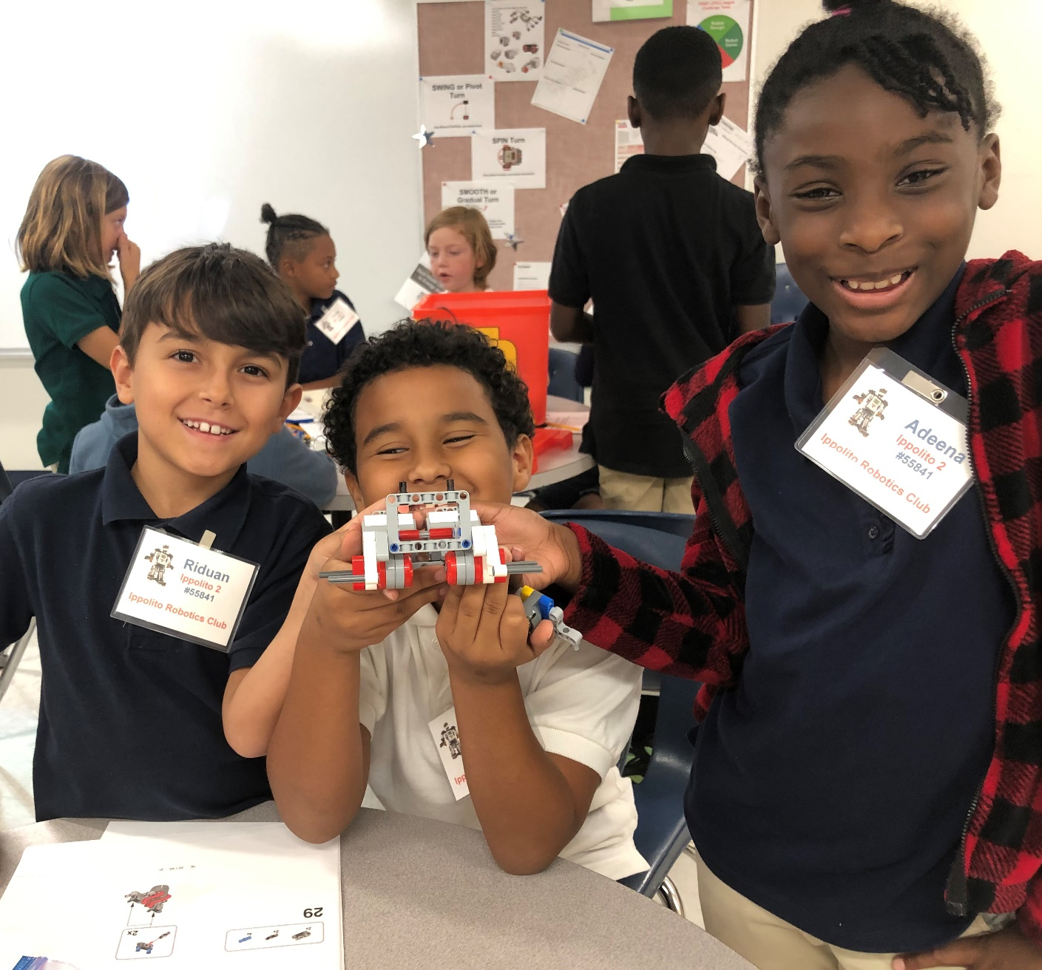
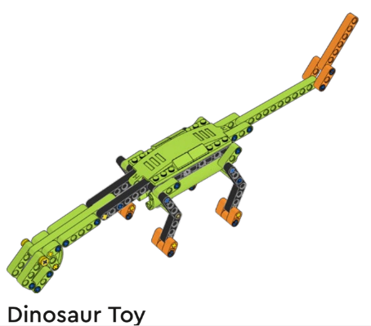
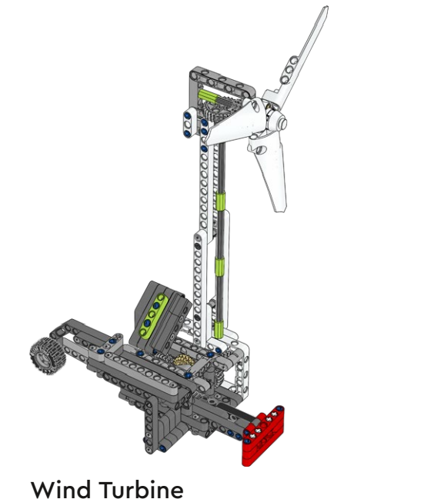
Robot Game
Gracious Professionalism
Partly In
Completely In
Precision Tokens
Two Technicians
20 Points if robot and attachments fit in Launch Area and less than 12 inches high

Slide 25
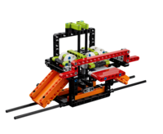
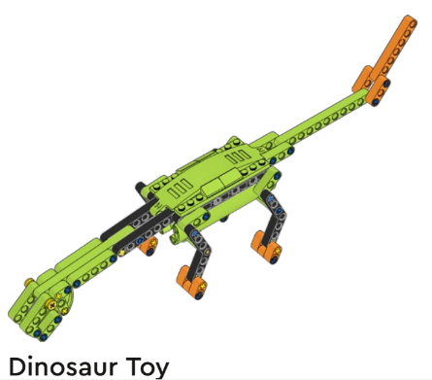
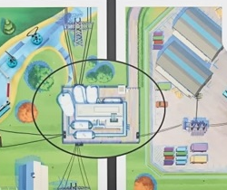
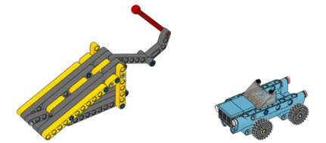
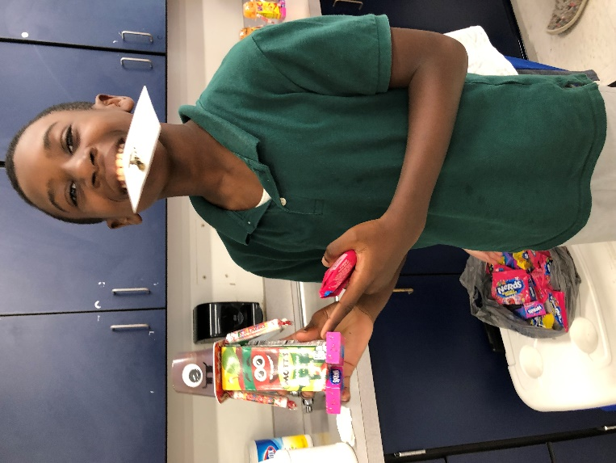
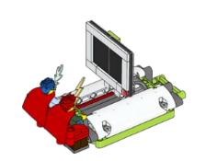

Power Station
Dinosaur Toy
Innovation
Project
Model
Hybrid Car
Watch TV
Wind

Slide 26
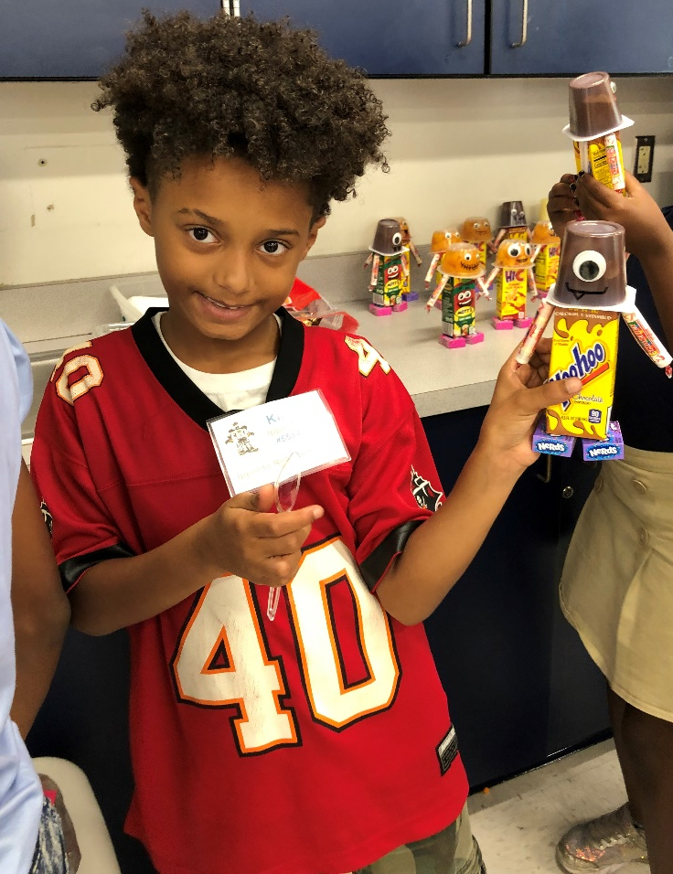
Complete
one form
for each
Mission

Slide 27
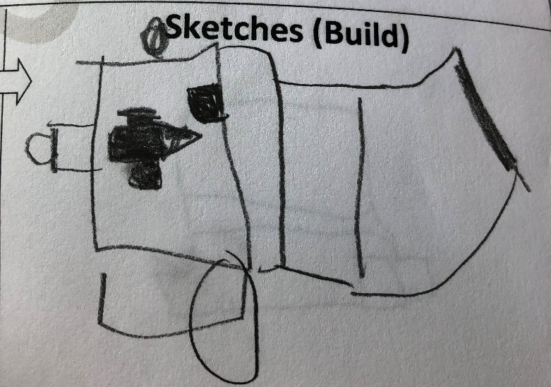
Engineers Complete Design Journal
Wind Turbine
Go Straight
____ inches
____rotations
Turn right
Push 3 times
Catch energy
Units
Turn left
Go backwards
To right launch
area
Robot travels from right launch area to
Wind Turbine, pushes 3 times and brings energy
Units back to launch area
PSEUDOCODE is a plain
language description of the steps
you want the robot to do.
(Task List)
Robot travels too far
Right turn is too much
Robot runs into turbine
Correct
Programming

Slide 28
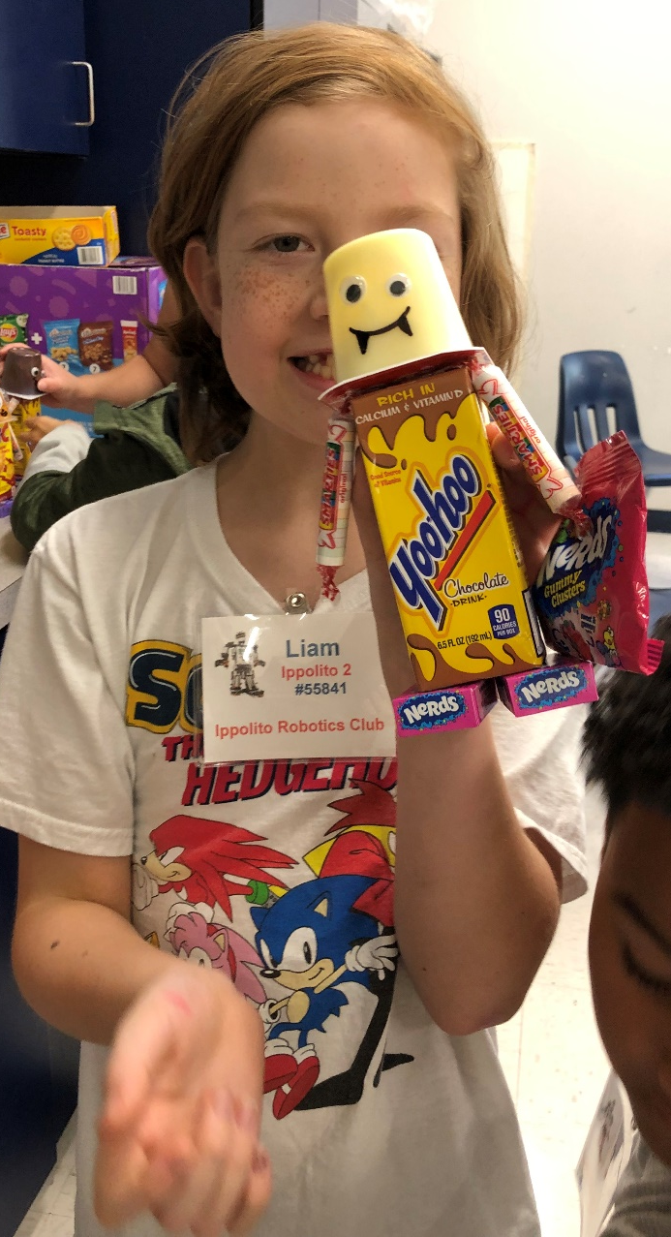
Robot strategy for Missions
Team discusses Mission strategy - two
technicians at each Launch Area – one robot
Complete the Wire Frame form to show path of robot for each mission
Use a different color for each mission path
After Missions decided, complete one Design Journal form for each mission
Each Design Journal form directs the programming for that Mission and attachment to build, if needed

Slide 29
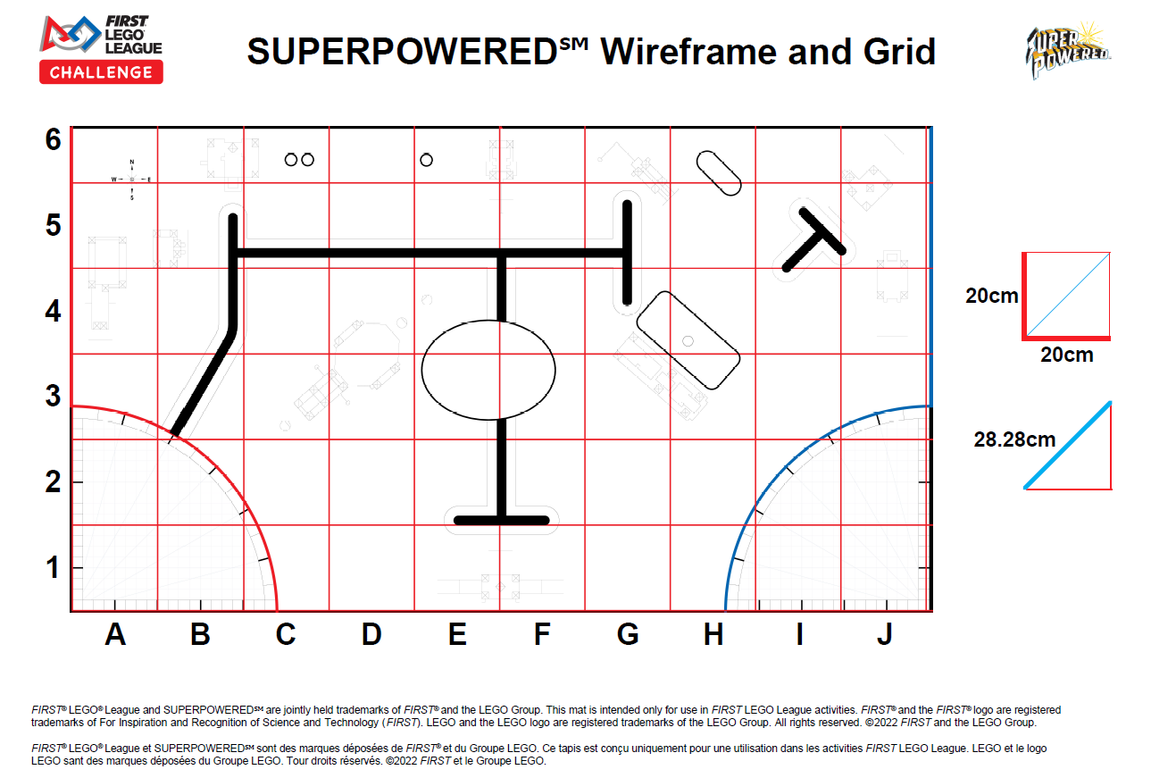
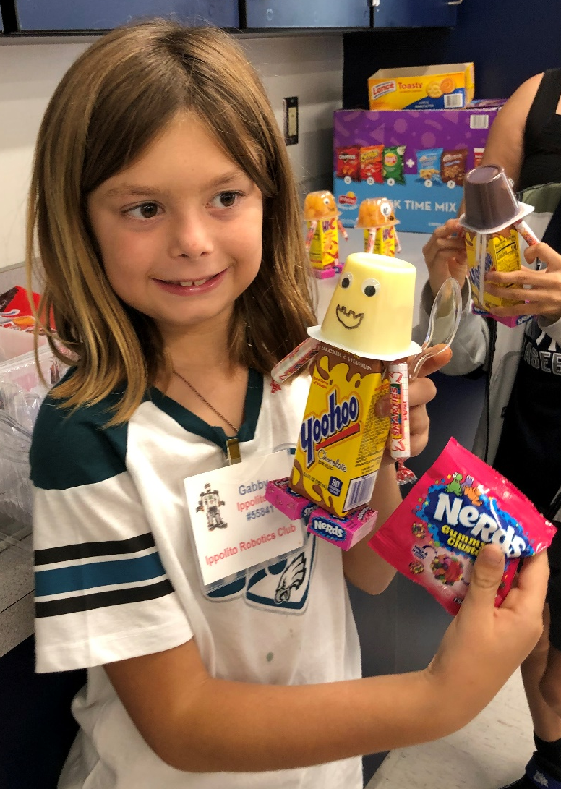

Slide 30
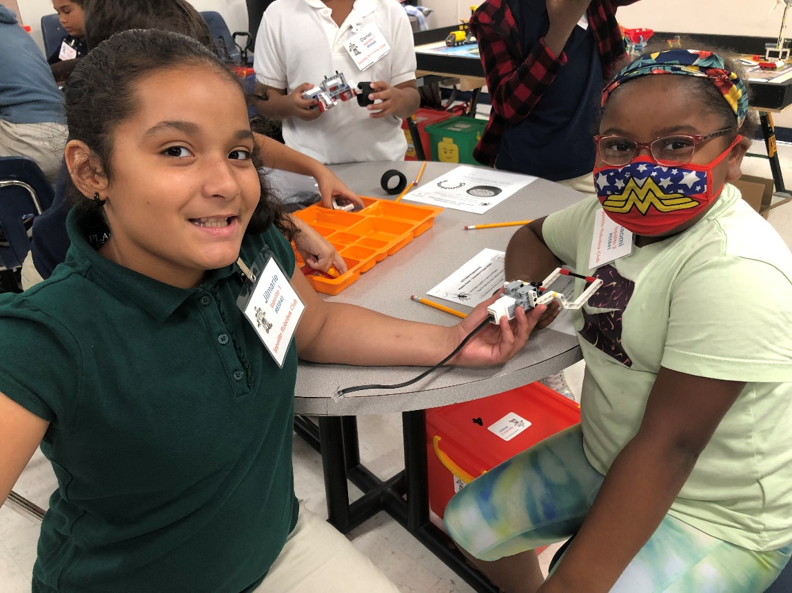
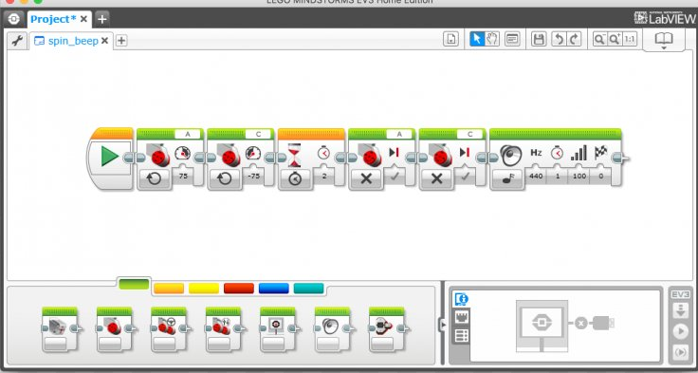
Programming robots
Click on this icon
Name
Your
Program
Press
Team Name – Put FORCE or Rebels
Program Name – Wind, TV, Car, Toy, Oil, Solar, IP Model, Smart Grid, etc
Create and name program on laptop, drag and
drop blocks needed, determine number of
rotations, etc. Download program into
robot. Run on Mission Board.

Slide 31
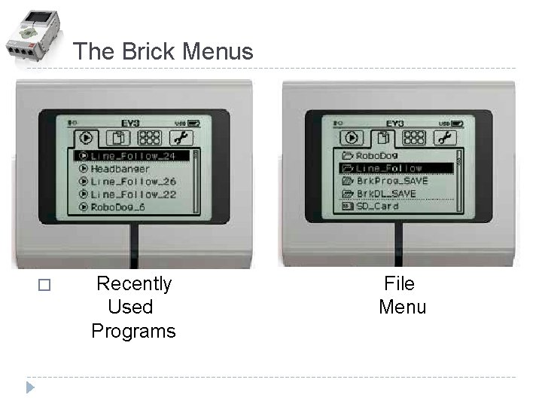
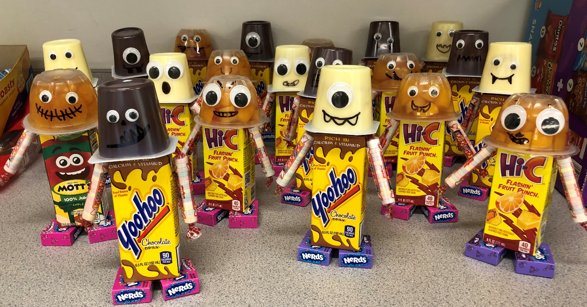
File Menu
4 Tabs
1-Run Recent
2-File Menu
3-Brick
Application
4-Settings

Slide 32
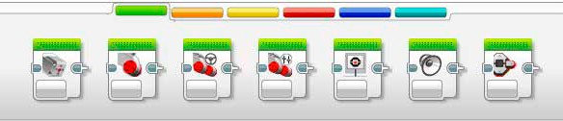
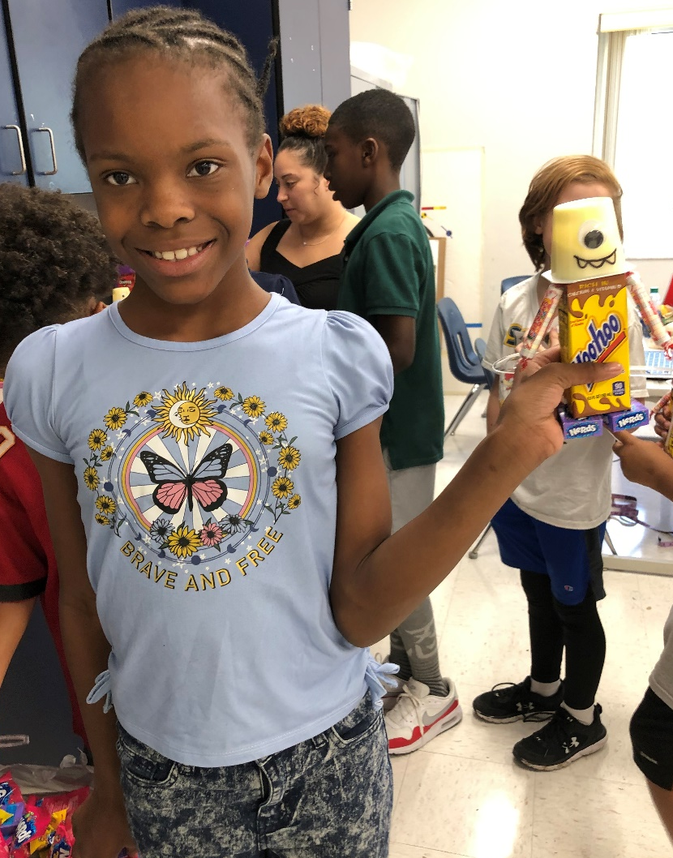


Action Blocks
MOVE Steering
MOVE TANK
Flow Blocks
Wait
Loop
Switch
Sensor Blocks
Ultrasonic

Slide 33
Programming robots
Click on this icon
Name
Your
Program
Press
Team Name
Program Name
Create and name program on laptop, drag and
drop blocks needed, determine number of
rotations, etc. Download program into
robot. Run on Mission Board.

Slide 34
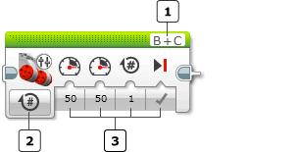

B & C are the standard motor ports for the wires to left(B) and right(C) motors
Rotations of tires
Choices-speed, number of rotations, stop
MOVE TANK Forward
Rotations
Start Button
Left
Wheel
Right
Wheel

Slide 35
MOVE TANK Backward
Rotations
Start Button
Left
Wheel
Right
Wheel
Add Minus sign
(-) to number of
rotations

Slide 36

Move Forward, Wait one second, Move Backward
Move Tank
Wait
Move Tank

Slide 37



Moving items with robot
Medium Motor
Power 40
Arm Move -.25
Arm moves
Down
Move Tank
Measure how
Far to travel
Arm is Up
Move Tank
Return, use
- number
On for Rotations
On for Rotations
May want to add Wait blocks

Slide 38



The LOOP
Program to
Repeat here
Means Infinity, Continuous
Select # Sign-This means number of times to repeat
Insert number of times to repeat program inside

Slide 41

MOVE STEERING
Both Wheels
Both Wheels
Rotations

Slide 42

Name program,
“Model”
Save under team
/table name,
“Coach 01”

Slide 43
Programming The Robot
Robot must be turned on (green light) to download program from computer
You can name your robot – look under settings, the last tab
If robot stops and the green light is flashing, this means that the program is asking the robot to do something it cannot do! Change the program ☺

Slide 44


Slide 45


Slide 46

Delete practice programs
Turn on robot and laptop
Plug in download cord to robot
Go to program page on laptop
Select “Tools” and “Memory Browser”
Delete practice programs and others
you do not need

Slide 47

Add Touch Sensor to Robot
Use 2 connectors
To attach Touch
Sensor
Wire inserts to Port 1

Slide 48


Slide 49

Add ultrasonic Sensor to Robot
Add Ultrasonic Sensor
to Robot
Wire for Ultrasonic
Sensor Goes into
Port 4

Slide 50

Program for ultrasonic sensor

Slide 51









Robot Design - Building with legos

Slide 52

Robot ATTEMPTS Missions on board
Robot has
2.5 minutes
to solve as
many missions
as possible.
There are 15
Missions.

Slide 53

Fun Hats or Costumes!

Slide 54




Robotics is fun

Slide 55



Congratulations teams!

